Slide 1



Rail's three genetic technologies future-proof freight and passenger positioning
DR. DAVE VAN DER MEULEN
Managing Member

Slide 2
INTRODUCTION
Positioning rail for competitiveness and sustainability
Leveraging rail’s genetic technologies
Rail’s defences
Rail’s wins and challenges
Conclusion
Images are named from top left to bottom right: Please see the second-last slide for credits

Slide 3
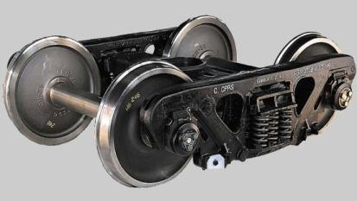
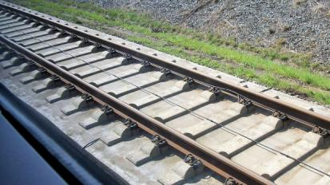
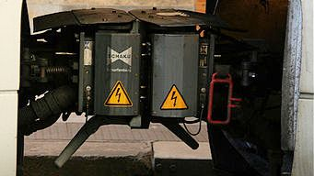
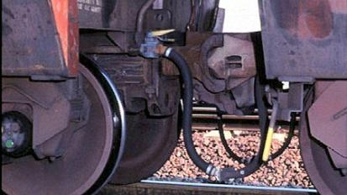
Rail’s three genetic technologies distinguish it from other modes
POSITIONING RAIL FOR COMPETITIVENESS AND SUSTAINABILITY
Supporting—
Heavy axle load
Guiding—
High speed
Coupling—
Long trains
Genetic Technologies
Images: Heavy haul bogie; ICE track; Scharfenberg coupler; Heavy haul coupler, author’s own work

Slide 4
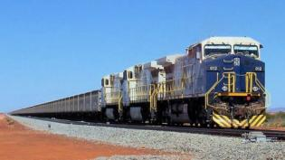
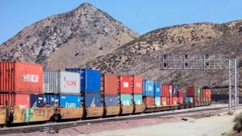
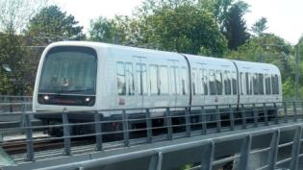
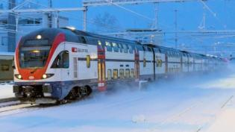
Rail’s four inherently competitive market spaces
POSITIONING RAIL FOR COMPETITIVENESS AND SUSTAINABILITY
Heavy axle load
Supporting
Light axle load
The third
genetic technology,
Coupling, strengthens
each of the
four market spaces
Heavy haul
Heavy intermodal
Urban guided transit
Higher speed
10^{1.x} km/h
10^{2.x} km/h
Low speed
Guiding
High speed
Images: Fortescue Metals Group; Cajon intermodal; Danishmetrotrain; SBB RABe 511

Slide 5
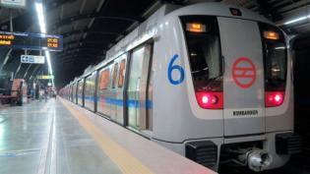
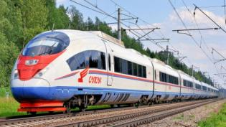
Rail’s four inherently competitive market spaces
POSITIONING RAIL FOR COMPETITIVENESS AND SUSTAINABILITY
Heavy axle load
Supporting
Light axle load
The third
genetic technology,
Coupling, strengthens
each of the
four market spaces
Heavy haul
Heavy intermodal
Urban guided transit
High speed
10^{1.x} km/h
10^{2.x} km/h
Low speed
Guiding
High speed
Images: Fortescue Metals Group; Cajon intermodal; Delhi Metro; Sapsan

Slide 6
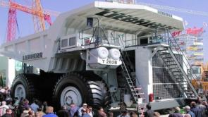
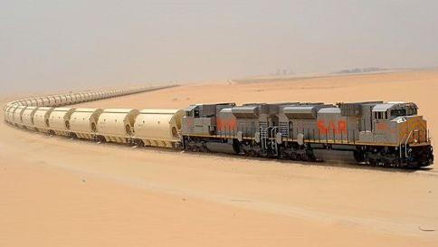
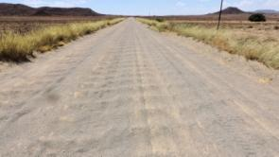
Rail’s eminent domain—position with care, compete with caution
POSITIONING RAIL FOR COMPETITIVENESS AND SUSTAINABILITY
Images: Liebherr T282B; SAR phosphate train; Corrugated road, author’s own work

Slide 7
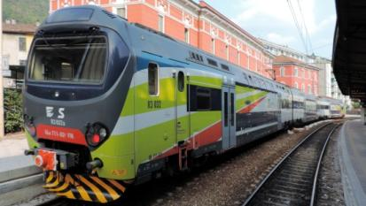
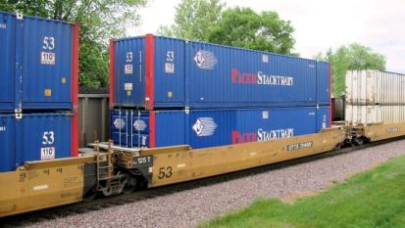
Supporting—increase axle load by double-decking, double-stacking
LEVERAGING RAIL’S GENETIC TECHNOLOGIES
Containers typically convey
high-value low-density goods—
double stack
to achieve heavy haul axle load
Humans as payload are light;
a 200-passenger crush load weighs only 15 tonnes—
double deck
to maximise axle load
Images: Como Nord, author’s own work; Double stack well car

Slide 8
Guiding—popularising high and higher speed as development tool
LEVERAGING RAIL’S GENETIC TECHNOLOGIES
Data represent 200km/h and higher
Sources: https:// en.wikipedia.org/wiki/List_of_countries_by_GDP_(PPP)_per_capita and en.wikipedia.org/wiki/High-speed_rail

Slide 9
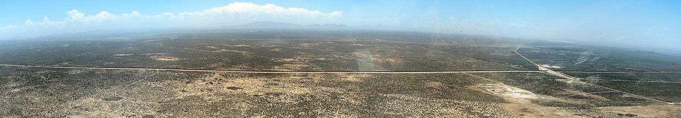
Coupling—reduces average headway to increase throughput
LEVERAGING RAIL’S GENETIC TECHNOLOGIES
Throughput, million tonnes/year 60
Wagon payload, tonnes 100
Mean wagon headway, seconds 50
Very short headways require double track
Single-line standard-gauge conveys 150 x 10⁶ tonnes
or 12 x 10⁶ TEUs
per direction per year
Image: Sishen Saldanha iron ore train

Slide 10
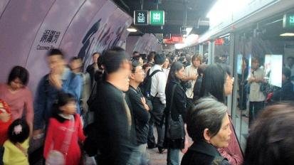
Coupling—reduces average headway to increase throughput
LEVERAGING RAIL’S GENETIC TECHNOLOGIES
Consider a heavy metro with
10-car trains at 2-minute headway:
Mean car headway = 2 x 60/10 = 12 seconds
Line capacity = 200 passengers/car
x 10 cars x 30 trains/hour
= 60 000 passengers/hour/direction
or 16 passengers/second/direction
Autonomous on-demand personal transportation
must succeed within this frame of reference
Image: Causeway Bay

Slide 11
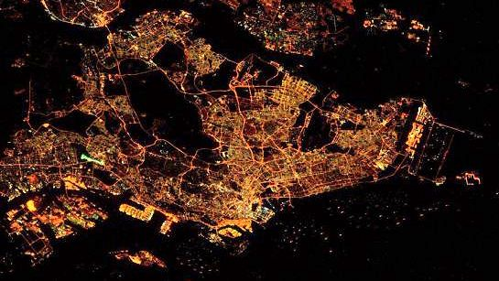
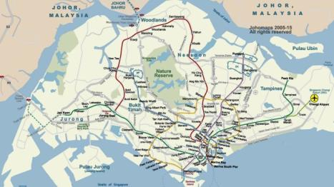
Transit oriented development is embedded in good practice
RAIL’S DEFENCES
Image: Singapore satellite

Slide 12
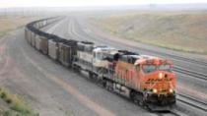
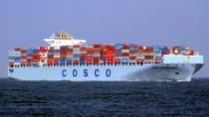
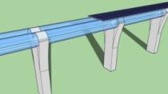
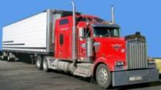
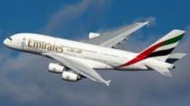
Man has used the wheel for millennia to achieve high lift / drag
RAIL’S DEFENCES
Images: Powder River Basin, author’s own work; Cosco Guangzhou; Hyperloop; Class 8 Kenworth; A6-EDY A380 Emirates

Slide 13
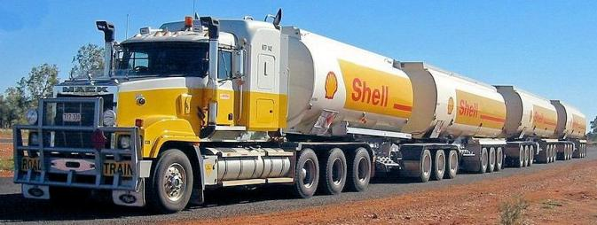
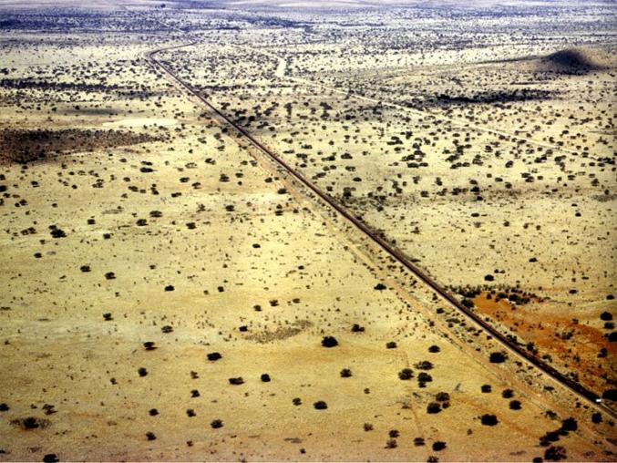
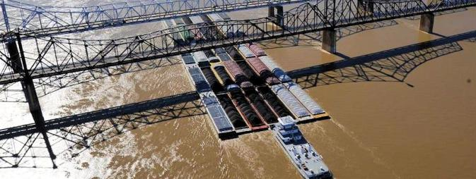
Rail’s scalability exceeds all other modes, some do not scale at all
RAIL’S DEFENCES
4 Trailers
Maximum 42 barges
660 Wagons
Images: Northern Territory 2AB-quad road train; World record train, author’s photo album; Lower Mississippi barge

Slide 14
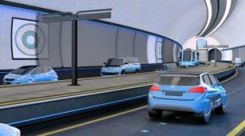
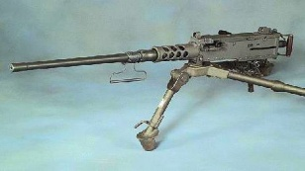
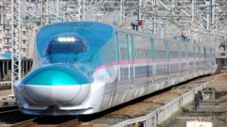
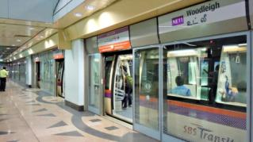
Passenger throughput exceeds all other land transport modes
RAIL’S DEFENCES
Road in metro tunnels
Browning machine gun
High speed
Heavy metro
0
10 000
20 000
30 000
40 000
50 000
60 000
Passengers per hour per direction
Images: www.thefutureoftransportconference.com/; Machine_gun_M2_1; E5 series; Platform screen doors; Northern Line

Slide 15
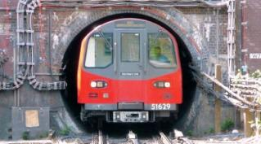
Passenger throughput exceeds all other land transport modes
RAIL’S DEFENCES
Road in metro tunnels
Browning machine gun
High speed
Heavy metro
0
10 000
20 000
30 000
40 000
50 000
60 000
Passengers per hour per direction
Images: www.thefutureoftransportconference.com/; Machine_gun_M2_1; E5 series; Platform screen doors; Northern Line

Slide 16
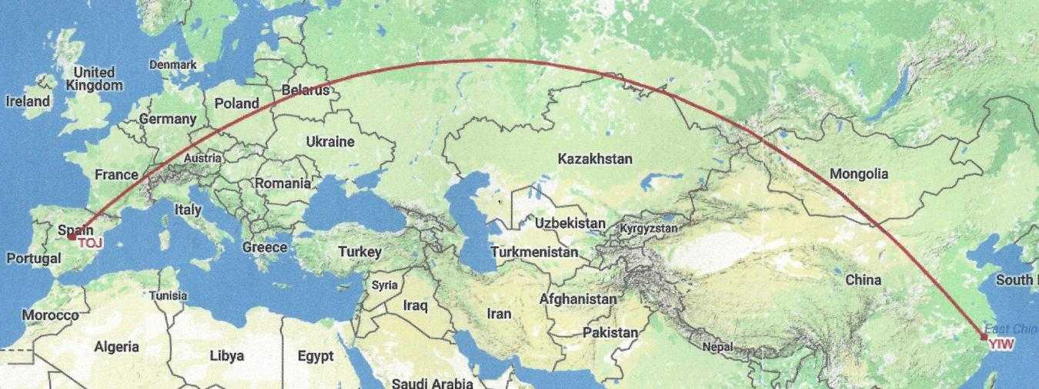
Great circle routes are shorter, faster and consume less energy
RAIL’S WINS—TRADITIONAL MARITIME BUSINESS
10 330km
Map data: Google, INEGI, Great Circle Mapper

Slide 17
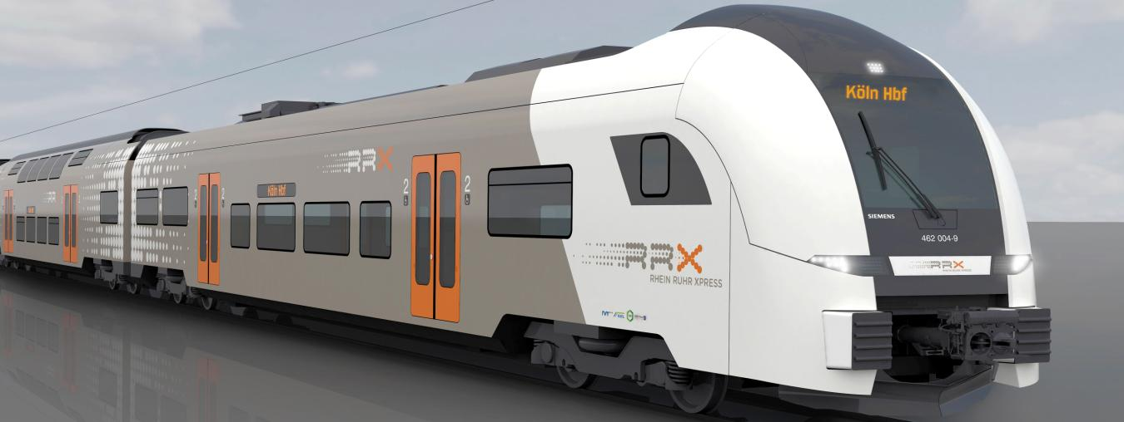
Larger conurbations need longer-distance higher-speed mobility
RAIL’S WINS—THE GLOBAL RISE OF REGIONAL RAIL
www.siemens.com/press/IM2015030550MO

Slide 18
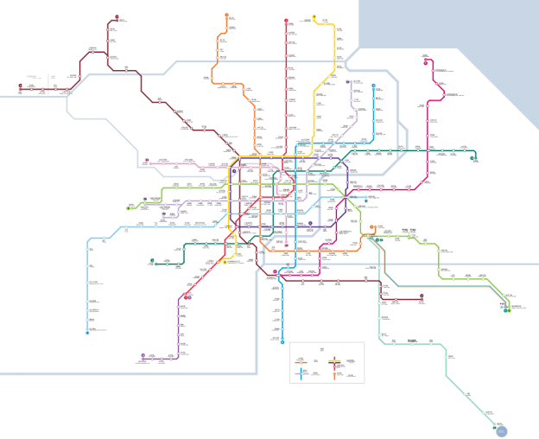
What on-demand aerial transport could do better
RAIL’S CHALLENGES
Urban guided transit
is not good at skipping stops—
all passengers necessarily
stop at all stations
Changing lines
supports comprehensive coverage
but is inconvenient
and may be time consuming
Direct transit would be great!
Image: Shanghai Metro

Slide 19
A cluster analysis from WCRR 2006
CONCLUSION: RAIL IS VIGOROUSLY REPOSITIONING ITSELF
From:
Van der Meulen, RD & Möller LC. 2006. Railway globalization: Leveraging insight from developed- into developing regions. Proc. 7th World Congress on Railway Research. Montréal, Canada

Slide 20
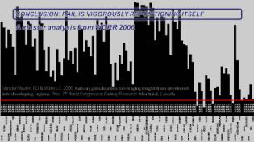
A cluster analysis from WCRR 2016
CONCLUSION: RAIL IS VIGOROUSLY REPOSITIONING ITSELF
From:
Van der Meulen, RD & Möller LC. 2016. Policy considerations for positioning rail as logistics
and mobility leader in 2050. Proc. 11th World Congress on Railway Research. Milan, Italy

Slide 21
IMAGE CREDITS
A6-EDY A380 Emirates, by Maarten Visser from Capelle aan den Ijssel, Nederland - A6-EDY A380 Emirates 31 jan 2013 jfk, CC BY-SA 2.0, https://commons.wikimedia.org/w/index.php?curid=56233674
Cajon intermodal, by Doug Wertman from Rogers, AR, USA - Cajon Intermodal, CC BY 2.0, https://commons.wikimedia.org/w/index.php?curid=11342686
Causeway Bay, by mailer_diablo - self-taken (Unmodified), CC BY-SA 3.0, https://commons.wikimedia.org/w/index.php?curid=45573
Class 8 Kenworth W900, by I, PRA, CC BY 2.5, https://commons.wikimedia.org/w/index.php?curid=2268675
Cosco Guangzhou, by AlfvanBeem - own work, CC0, https://commons.wikimedia.org/w/index.php?curid=18372888
Danishmetrotrain, by Gadgetbox at English Wikipedia - Transferred from en.wikipedia to Commons., Public Domain, https://commons.wikimedia.org/w/index.php?curid=1675733
Delhi Metro, by WillaMissionary - own work, Public Domain, https://commons.wikimedia.org/w/index.php?curid=30739570
Double stack well car, by Slambo at en.wikipedia - Transferred from en.wikipedia., CC BY-SA 2.0, https://commons.wikimedia.org/w/index.php?curid=250799
E5 series, by Toshinori baba - own work, CC0, https://commons.wikimedia.org/w/index.php?curid=14492814
Fortescue Metals Group, by Geez-oz - own work, CC BY-SA 3.0, https://commons.wikimedia.org/w/index.php?curid=14897092
Hyperloop, by Edit1306 - own work, CC BY-SA 3.0, https://commons.wikimedia.org/w/index.php?curid=27709809
ICE track, by Photnart - own work, CC0, https://commons.wikimedia.org/w/index.php?curid=26572319
Liebherr T282B, by René Engel - self-made, originally uploaded to de.wp, CC BY-SA 3.0, https://commons.wikimedia.org/w/index.php?curid=409349
Lower Mississippi barge, by DOD - https://www.defense.gov/News/Article/Article/1046239/army-engineers-coast-guard-partner-to-chart-us-water-navigations-future, Public Domain, https://commons.wikimedia.org/w/index.php?curid=55002361
Machine_gun_M2_1, work of the US Federal Government, image in public domain
Northern Line, by SPSmiler - own work, Public Domain, https://commons.wikimedia.org/w/index.php?curid=400148
Northern Territory 2AB-quad tanker road train, by Thomas Schoch - own work at www.retas.de/thomas/travel/australia2005/, CC BY-SA 3.0, https://commons.wikimedia.org/w/index.php?curid=671214
Platform screen doors, by Seloloving at English Wikipedia, CC BY 3.0, https://commons.wikimedia.org/w/index.php?curid=16071007
Sapsan, by Sergey Korovkin 84 - own work, CC BY-SA 3.0, https://commons.wikimedia.org/w/index.php?curid=33819906
SAR phosphate train, available for free download at https://www.networkrailmediacentre.co.uk/resources/sar-phosphate-train#
SBB RABe 511, by Kabelleger / David Gubler - own work, also available at https://bahnbilder.ch/picture/16447, CC BY-SA 4.0, https://commons.wikimedia.org/w/index.php?curid=50731016
Scharfenberg coupler, by Sebastian Terlfoth User:Sese_Ingolstadt - own work, CC BY-SA 3.0, https://commons.wikimedia.org/w/index.php?curid=2932033
Singapore satellite, credit NASA/JSC, U.S. Astronaut & Station Commander Tim Kopra Date: March 19, 2016, http://www.todayonline.com/singapore/singapore-night-350-km-above-earth
Sishen Saldanha Iron ore train, by Abri le Roux / abrileroux -at- gmail.com. MSGJ at English Wikipedia - http://drop.io/sishensaldanhatrein/asset/sishensaldanha-jpg, CC BY-SA 3.0, https://commons.wikimedia.org/w/index.php?curid=11680529
Shanghai Metro, by Daniel129 - own work, CC BY-SA 4.0, https://commons.wikimedia.org/w/index.php?curid=48930525

Slide 22
Thank you! www.railcorpstrat.com

